Slide 1


Sprint 1
SPROUTME CAPSTONE PROGRESS
Seth Aguilar · Warren Christian
Quinnlan McCarthy · Itay Shemesh
October 2026
SM

Slide 2
NDA disclosure
We can show the product UI
and summarize our work.
We cannot share private code
or internal documentation.
SM

Slide 3
ONBOARDING
  SproutMe was already in development when we joined.
  We learned how its app, API, and database fit together.
  Development setup requires us to run local scaffolding of the product stack.
SM

Slide 4
SPRINT OBJECTIVES
  Onboard into SproutMe’s existing platform
  Deliver assigned Jira items through team review
  Improve onboarding, navigation, and UI
SM

Slide 5
REQUIREMENTS GATHERING
  Regular standups with the client
  Team reports progress and receives new work
  Client helps onboard us to the platform
  Jira items and designs refine requirements
SM

Slide 6
HOW WE TRACKED WORK
  21 Jira items were assigned in this reporting window across the entire group.
  Progress with current work determines what is assigned next.
SM

Slide 7
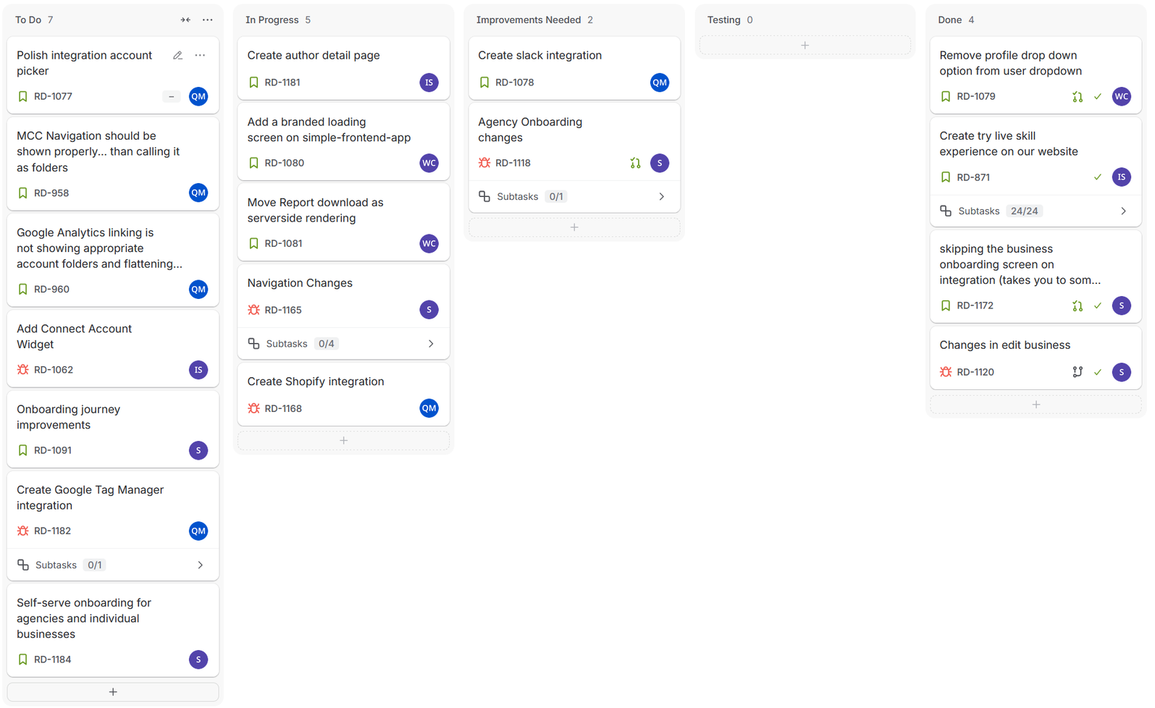
Jira Board

Slide 8
OVERALL FEATURES WORKED ON THIS SPRINT
  Team invite system for users who work in large marketing teams.
  Connecting to external services like Slack.
  Good UI experience.
  Account connection widget
SM

Slide 9
SETH AGUILAR
  Assigned work: agency and business onboarding.
  Improved Add Team, team table, and business editing.
  Navigation tasks cover business switching and branding.
  Status: 2 done; other work is active, testing, or queued.
  Next: finish the wider self-serve onboarding journey.
SM

Slide 10
WARREN CHRISTIAN
  Mainly UI changes
  Removed an dropdown option from the profile menu.
  Built loading visuals; stability fixes remain under review.
  Server-rendered report downloads are in progress.
SM

Slide 11
QUINNLAN MCCARTHY
  Slack connection work is in revision; Shopify is active.
  Google account picker and account hierarchy are queued.
SM

Slide 12
ITAY SHEMESH
  Assigned work: website skill trial and related pages.
  Jira marks the skill-trial parent item Done.
  The author detail page is in progress.
  A Connect Account widget is queued.
SM

Slide 13
RESPONSIBLE AI USE
  GenAI used extensively during development
  Each change verified in the local environment
  Pull requests receive human review
  CI/CD and AI reviewer agents add checks
  Merges require the team to resolve findings
SM

Slide 14
ACHIEVEMENTS & CHALLENGES
  Each member is assigned their own work and are siloed.
  Challenge: onboarding within an existing platform
  Challenge: private code limititations for class assignments
SM

Slide 15
DEMO
SM

